Slide 1
Employee Data Analysis using Excel
STUDENT NAME: KIRTHIKA B
REGISTER NO :
DEPARTMENT : BACHELOR’S OF COMMERCE
COLLEGE : VALLIAMMAL COLLEGE FOR WOMEN

Slide 2
PROJECT TITLE
Employee Performance Analysis using Excel

Slide 3


AGENDA
Problem Statement
Project Overview
End Users
Our Solution and Proposition
Dataset Description
Modelling Approach
Results and Discussion
Conclusion
3/21/2024 Annual Review

Slide 4

PROBLEM STATEMENT
*Tracking and recording of performance metrics (sales, customer satisfaction, project completion rates).
*Visualization of performance trends and patterns using charts and graphs .
*Identification of top-performing employees and areas for improvement.
*Personalized recommendations for employee development and growth.
*Data-driven decision-making for promotions, bonuses, and training programs .

Slide 5

PROJECT OVERVIEW
This project focuses on analysing employee data to identify trends and
And insights that can drive better decision.
Excel will be used to clean, organize, and visualise key metrics such as
Employee demographics, performance, and rention rates.
The analysis will highlights areas of improvement in workforce management
Helping to optimize resource allocation.
Outcomes will include detailed reports and dashboard for management
Review.
The finding aim to support strategic planning.
.

Slide 6


WHO ARE THE END USERS?
The end users of the employee data employee data analysis are HR
Managers team leads and senior management.

Slide 7

OUR SOLUTION AND ITS VALUE PROPOSITION
Conditional formatting – highlight's missing cells
Filter – helps to remove the empty cells
Formulas – helps to identify the performance of employees
Pivot table – helps summarize
Pie chart – shows the data

Slide 8
Dataset Description
1. Employee ID
2. First name
3. Last name
4. Business unit
5. Employee classification type
6. Employee type
7. Gender
8. Performance score
9. Current employee rate
10. Performance level

Slide 9

THE "WOW" IN OUR SOLUTION
PERFORMANCE LEVEL
=IF(Z8=5,”VERYHIGH”,IF(Z8>=4,”HIGH”,IF(Z8=3,”MED”,IF(Z8=2,”LOW”))))
3/21/2024 Annual Review
9

Slide 10
MODELLING
DATA COLLECTION
*Identification
*Gathering
*Preparation
DATA CLEANING
*Standardisation dilation
*Correction
*Validation
SUMMARY
Data analysis involves examining, transforming, and modelling data to
Extract insights , identify patterns, and support decisions-making.
10

Slide 11
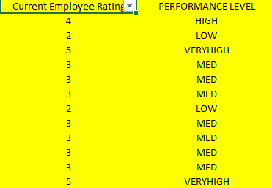
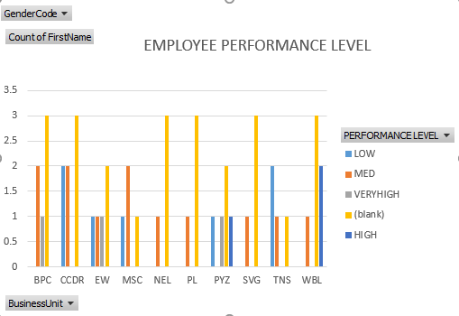
RESULTS
11

Slide 12
conclusion
* IN CONCLUSION, the employee data analysis conducted using Excel
Provided valuable insights into workforce trends enabling more
Informed decision-making.
The use of Excel allowed efficient data organization, visualization
and reporting, ultimately helping to enhance HR strategies, improve
and employee satisfaction and optimize overall organizational
performance.

